Slide 1

CONTACT TYPE HUMAN BODY
PULSE RATE DETECTION USING CAMERA
(Usage Of FFT Algorithm)
Ameya Kathapurkar(mug739), Omkar Paranjape(dyj924), Swanand Mhalagi(lwv826)

Slide 2
CONTENTS
Pulse Detection Method
Pulse Detection using I-phone 6+ Camera
Motivation from DSP
Block by Block Construction
Challenges
Partial Result
Conclusion and Future Targets

Slide 3

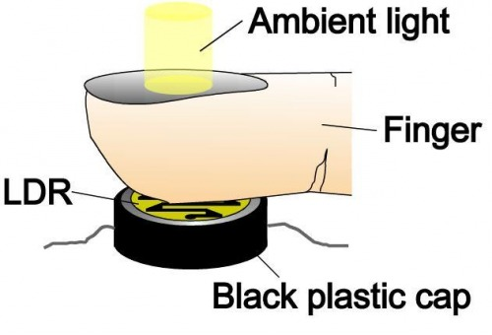
1. Pulse Detection Method
Contact Type Finger Pulse Detection

Slide 4
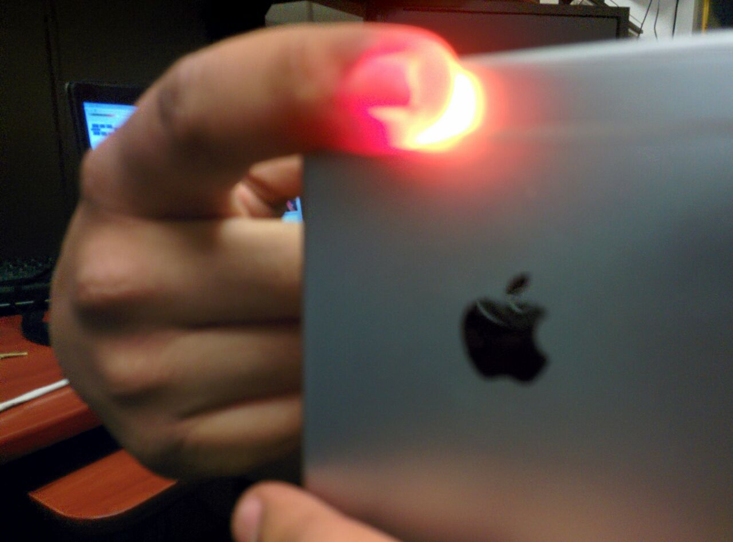
CONTACT TYPE HUMAN BODY
PULSE RATE DETECTION USING CAMERA

Slide 5

2. Pulse Detection using I-phone 6+ Camera

Slide 6
3. Motivation from DSP
Use of Intensity Variation
Use of Filters
Use of Fast Fourier Transform

Slide 7
4. Block by Block Construction
Sliding-window Frequency Analysis
Video Signal Generation
(I-phone Camera)
Band Pass Filtering
(Butterworth Filter)
Fast Fourier Transform
Peak
Detection
Brightness Signal Computation
Smoothing

Slide 8
Video Acquisition, Brightness Computation and Band Pass Filtering
Video Capture from camera @ 60 fps
Assigning Video to a Variable and thereby reading every frame
385 Frames are observed in video
Red color is extracted from these frames
Because we need intensity variations in Red Color
Use of Bandpass Butterworth Filter to get interested band

Slide 9
Frequency Domain Translation of Signal using FFT
Use of FFT to have accurate results
Computes FFT of 1 * 385 Columns Matrix
Output gives Noise and requires Smoothing

Slide 10
Challenges
To perform sliding window analysis
Peak Detection and Smoothing
Increase the SNR by either decreasing noise or increasing power

Slide 11
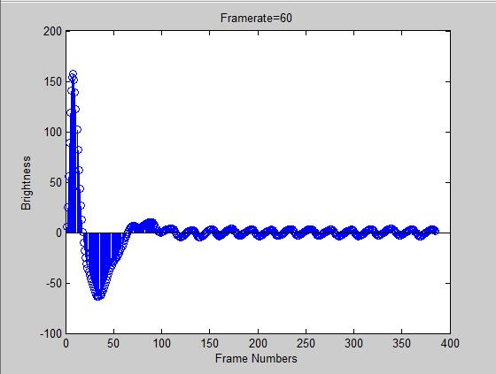
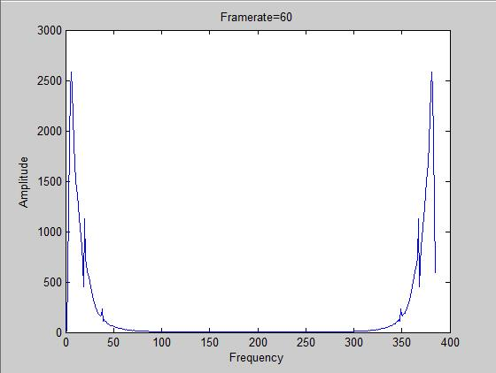
Partial Results
Frame Wise Brightness
Post FFT

Slide 12
Conclusions and Future Aspect
1. Still approximate result can be achieved and accurate Pulse Rate can be calculated by using more filters.
2. Eventually we want to display the pulse rate to the Consumer.

Slide 13
Reference
1. MIT, DSP Research
2. Guha Balakrishnan, Frédo Durand, John Guttag Detecting Pulse from Head Motions in Video
Computer Vision and Pattern Recognition (CVPR), 2013 IEEE Conference
3. Hao-Yu Wu, Michael Rubinstein, Eugene Shih, John Guttag, Frédo Durand, William T. Freeman
Eulerian Video Magnification for Revealing Subtle Changes in the World
ACM Transactions on Graphics, Volume 31, Number 4 (Proc. SIGGRAPH), 2012

